Slide 1
Software Construction & Development
COURSE INSTRUCTOR: Dr. Marriam Nawaz

Slide 2
Basics of Concurrency
Outline
Introduction to concurrency
Socket overview

Slide 3
How Modern Computers Handle Multiple Tasks?

Slide 4
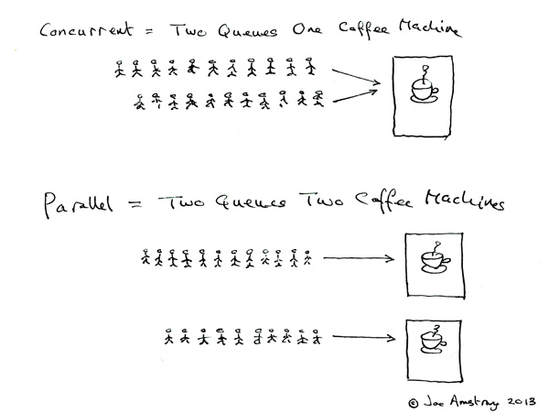
Parallelism and concurrency

Slide 5
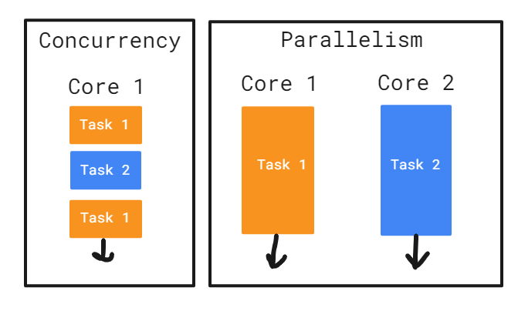
Parallelism and concurrency

Slide 6
Concurrency
Doing multiple things at a same time but not necessarily all at once
Multitasking
Task are running efficiently, even though they are not
Example:
download files from the internet
also processing user input.

Slide 7
Concurrency
Metrics to evaluate concurrent systems
1. Good Throughput
2. Good Responsiveness
These metrics ensure that a concurrent system
Handle multiple tasks
Staying fast and interactive for users.

Slide 8
Multitasking
Process based multitasking
Thread based multitasking

Slide 9
Multitasking
Process-Based Multitasking | Thread-Based Multitasking
Independent program | Smaller unit within a process
Running different programs | Running different tasks within the same program
Processes are more isolated and safer | Threads share memory and resources
Processes uses more resources. | Threads can interfere other programs

Slide 10
Process-Based Multitasking (Example)
📌 Example 1: Using Multiple Applications
👉 On your laptop:
Google Chrome (browser)
MS Word
VLC Media Player
✔ Each is a separate process ✔ If VLC crashes → Word is still safe
“Each program runs independently with its own memory.”

Slide 11
Thread-Based Multitasking (Example)
Example: WhatsApp / Messaging App
👉 Inside one app:
Thread 1 → Send message
Thread 2 → Receive messages
Thread 3 → Update UI
✔ All happen simultaneously

Slide 12
Discussion
👉 “If one tab in Chrome crashes, does whole Chrome close?”
Sometimes YES → because threads share memory
👉 “If VLC crashes, does Word close?”
NO → separate processes

Slide 13
Why Concurrency
1. Increased Speed
2. Efficient CPU Usage
3. Enhanced Responsiveness
4. Optimized Resource Allocation
5. Improved User Experience

Slide 14
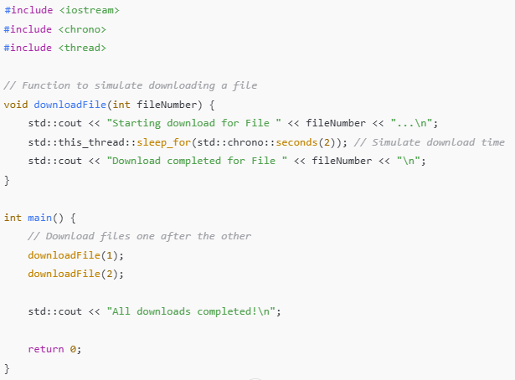
Code without Concurrency

Slide 15
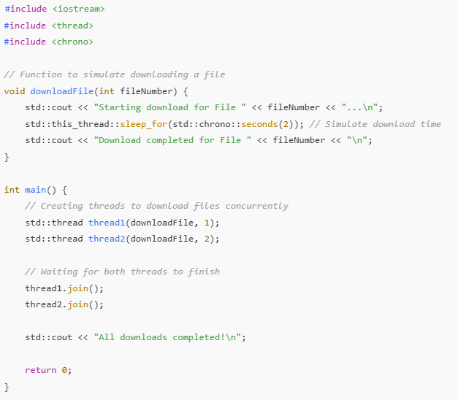
Code with Concurrency

Slide 16
Concurrency Drawbacks
Complexity.
Debugging Difficulties
Error Potential
Resource Contention
Notes:
Resource contention happens when multiple threads or processes try to use the same resource at the same time, but the resource cannot be shared simultaneously.

Slide 17
Two Models for Concurrent Programming
There are two common models for concurrent programming:
1. shared memory
2. message passing

Slide 18
Shared memory
In the shared memory model of concurrency, concurrent modules interact by reading and writing shared objects in memory.
examples of the shared-memory model:
A and B might be two processors (or processor cores) in the same computer, sharing the same physical memory.
A and B might be two programs running on the same computer, sharing a common filesystem with files they can read and write.
A and B might be two threads in the same Java program (we’ll explain what a thread is below), sharing the same Java objects.

Slide 19
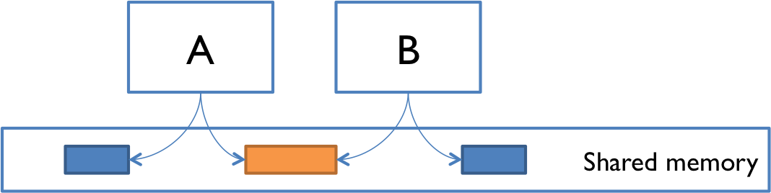
Shared memory

Slide 20
Message passing
In the message-passing model, concurrent modules interact by sending messages to each other through a communication channel. Modules send off messages, and incoming messages to each module are queued up for handling. Examples include:
A and B might be two computers in a network, communicating by network connections.
A and B might be a web browser and a web server – A opens a connection to B, asks for a web page, and B sends the web page data back to A.
A and B might be an instant messaging client and server.
A and B might be two programs running on the same computer whose input and output have been connected by a pipe, like ls | grep typed into a command prompt.
Notes:
ls (Program A) lists files Its output is sent as a message grep txt (Program B) receives that message as input grep filters and displays only .txt files

Slide 21
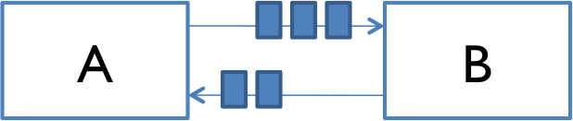
Message passing

Slide 22
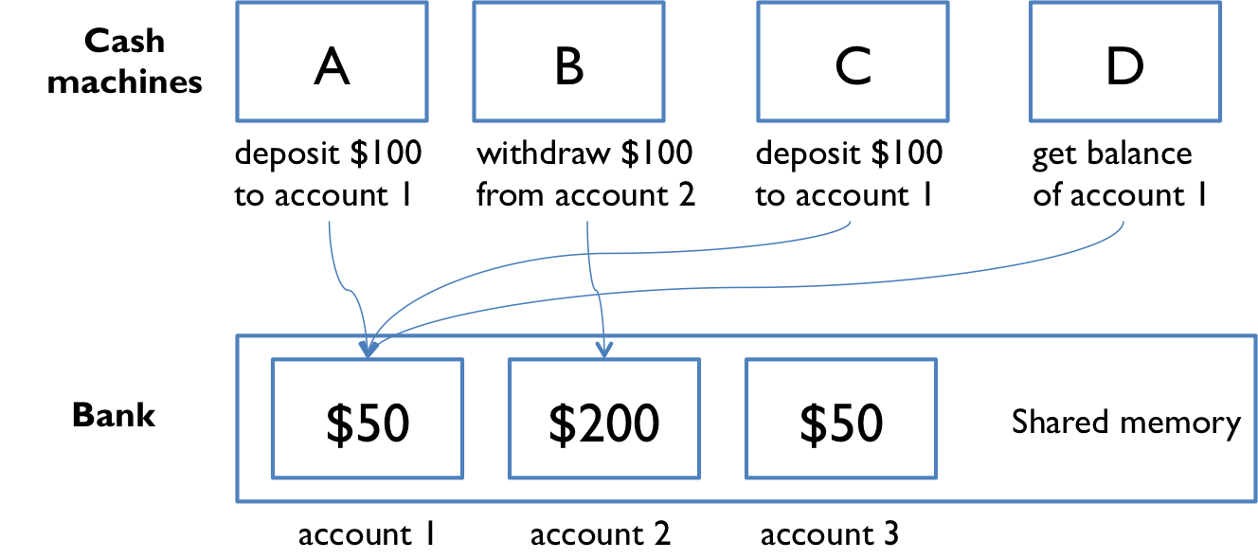
Shared Memory Example
Let’s look at an example of a shared memory system. The point of this example is to show that concurrent programming is hard, because it can have subtle bugs.
shared memory model for bank accounts
Imagine that a bank has cash machines that use a shared memory model, so all the cash machines can read and write the same account objects in memory.

Slide 23
Shared Memory Example
To illustrate what can go wrong, let’s simplify the bank down to a single account, with a dollar balance stored in the balance variable, and two operations deposit and withdraw that simply add or remove a dollar:
// suppose all the cash machines share a single bank account
private static int balance = 0;
private static void deposit() {
balance = balance + 1;
}
private static void withdraw() {
balance = balance - 1;
}

Slide 24
Shared Memory Example
Customers use the cash machines to do transactions like this:
deposit(); // put a dollar in
withdraw(); // take it back out
In this simple example, every transaction is just a one dollar deposit followed by a one-dollar withdrawal, so it should leave the balance in the account unchanged. Throughout the day, each cash machine in our network is processing a sequence of deposit/withdraw transactions.
// each ATM does a bunch of transactions that
// modify balance, but leave it unchanged afterward
private static void cashMachine() {
for (int i = 0; i < TRANSACTIONS_PER_MACHINE; ++i) {
deposit(); // put a dollar in
withdraw(); // take it back out
}
}

Slide 25
Shared Memory Example
So at the end of the day, regardless of how many cash machines were running, or how many transactions we processed, we should expect the account balance to still be 0.
But if we run this code, we discover frequently that the balance at the end of the day is not 0. If more than one cashMachine() call is running at the same time – say, on separate processors in the same computer – then balance may not be zero at the end of the day. Why not?

Slide 26
Shared Memory Example
Interleaving
Here’s one thing that can happen. Suppose two cash machines, A and B, are both working on a deposit at the same time. Here’s how the deposit() step typically breaks down into low-level processor instructions:
get balance (balance=0)
add 1
write back the result (balance=1)

Slide 27
Shared Memory Example
When A and B are running concurrently, these low-level instructions interleave with each other (some might even be simultaneous in some sense, but let’s just worry about interleaving for now):
A get balance (balance=0)
A add 1
A write back the result (balance=1)
B get balance (balance=1)
B add 1
B write back the result (balance=2)
This interleaving is fine – we end up with balance 2, so both A and B successfully put in a dollar.

Slide 28
Shared Memory Example
But what if the interleaving looked like this:
A get balance (balance=0)
B get balance (balance=0)
A add 1
B add 1
A write back the result (balance=1)
B write back the result (balance=1)
The balance is now 1 – A’s dollar was lost! A and B both read the balance at the same time, computed separate final balances, and then raced to store back the new balance – which failed to take the other’s deposit into account.

Slide 29
Race Condition
This is an example of a race condition. A race condition means that the correctness of the program (the satisfaction of postconditions and invariants) depends on the relative timing of events in concurrent computations A and B. When this happens, we say “A is in a race with B.”
Some interleavings of events may be OK, in the sense that they are consistent with what a single, nonconcurrent process would produce, but other interleavings produce wrong answers – violating postconditions or invariants.

Slide 30
Message Passing Example
Now let’s look at the message-passing approach to our bank account example.
Now not only are the cash machine modules, but the accounts are modules, too. Modules interact by sending messages to each other. Incoming requests are placed in a queue to be handled one at a time. The sender doesn’t stop working while waiting for an answer to its request. It handles more requests from its own queue. The reply to its request eventually comes back as another message.
Unfortunately, message passing doesn’t eliminate the possibility of race conditions. Suppose each account supports get-balance and withdraw operations, with corresponding messages. Two users, at cash machine A and B, are both trying to withdraw a dollar from the same account. They check the balance first to make sure they never withdraw more than the account holds, because overdrafts trigger big bank penalties:

Slide 31
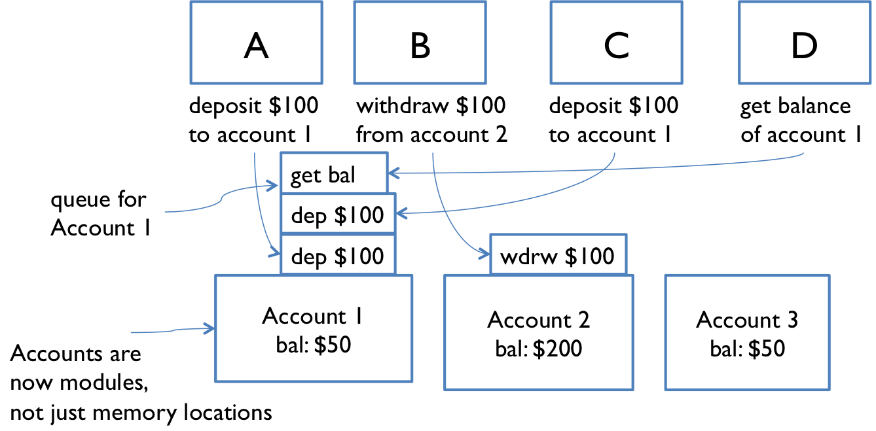
Message Passing Example

Slide 32
Message Passing Example
get-balance
if balance >= 1 then withdraw 1
The problem is again interleaving, but this time interleaving of the messages sent to the bank account, rather than the instructions executed by A and B. If the account starts with a dollar in it, then what interleaving of messages will fool A and B into thinking they can both withdraw a dollar, thereby overdrawing the account?
One lesson here is that you need to carefully choose the operations of a message-passing model. withdraw-if-sufficient-funds would be a better operation than just withdraw.

Slide 33
Concurrency is Hard to Test and Debug
Concurrency is Hard to Test & Debug
Race conditions are difficult to detect through testing
Even if found, it’s hard to locate the exact cause
Results are not consistent (non-reproducible)
Same program → different output each run
Behavior depends on timing factors, such as:
CPU scheduling
Other running programs
System load / network delays
Small changes (e.g., adding print statements) can hide the bug

Slide 34
THANKS

